Slide 1

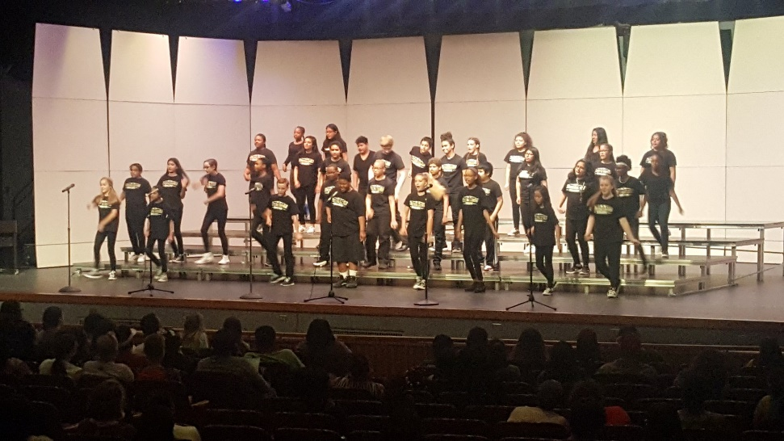
NORTHVIEW MIDDLE SCHOOL
Grade Six
Parent Curriculum Night
Welcome to Northview Middle School
5th Grade
Curriculum Night
Notes:
Kaiser

Slide 2
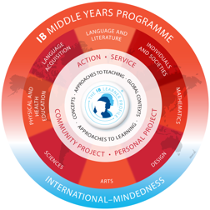
IB: Middle Years Program
A five-year program for students aged eleven through sixteen; grades 6-10 in Washington Township.
The framework encompasses eight subject areas, providing a balanced education for adolescents.
The framework challenges and encourages all students to make connections between their learning and the real world.
Students understand concepts and skills within subjects and across subjects.
Students explore the impact of their actions on the world around them and throughout the planet.
Notes:
Kaiser

Slide 3
Sixth Grade Teams
Butler University
Indiana University
Approximately 130 students and five core teachers per team
At least one section of Language and Literature X, Science X, and Individuals & Societies X per team
Notes:
HB

Slide 4
A Typical Day
Falcon Day (Monday) – Blocks 1-8 (42-minute classes)
Block scheduling the rest of the week:
  83 minutes for each required class on alternating days
  Gold Days (Tues/Thurs)– Blocks 1, 3, 5, 7
  Black Days(Wed/Fri) – Blocks 2, 4, 6, 8
Parent Tip: Encourage your child to complete homework on the night it’s assigned!
Notes:
HB

Slide 5
The Role of the School Counselor
School Guidance Curriculum
  Academic success skills & learning styles
  Career exploration
Individual Student Planning
  Personal goals
  Planning for Careers and College
Responsive Services
  Individual and group counseling
  Consultation with parents, teachers, and other professionals
  Referrals to other school support services or community resources
Scheduling
Notes:
DODSON

Slide 6
Setting Up your Child for Academic Success
Your child will need your help to navigate this huge transition!
Organization
  Locker, binder, agenda book, etc.
Time management
  Daily homework, large projects
Study habits
  HOW to study (different from doing homework)
Agenda Book
Utilize Skyward
Check the Homework Hotline ONLINE
Notes:
NEWSOME

Slide 7
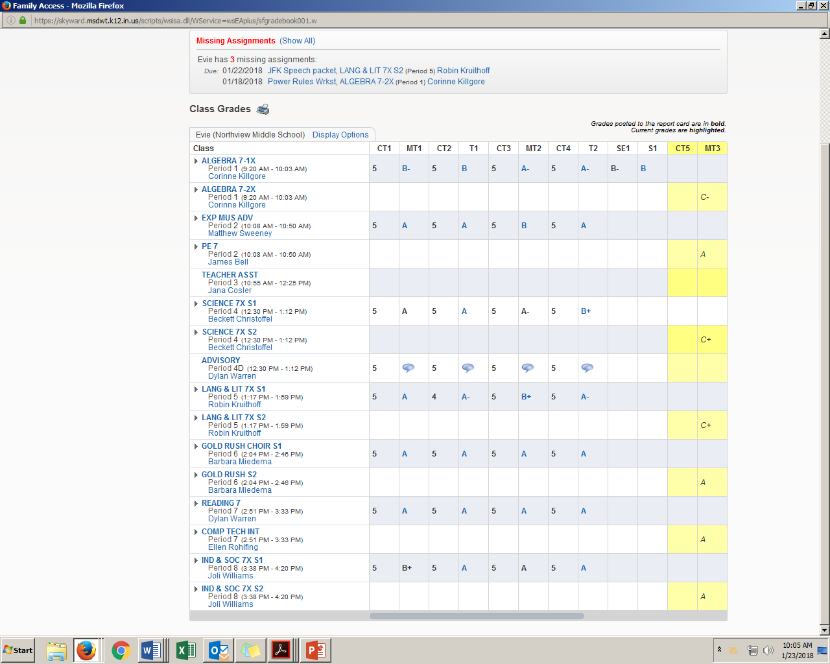
A peek into Skyward

Slide 8
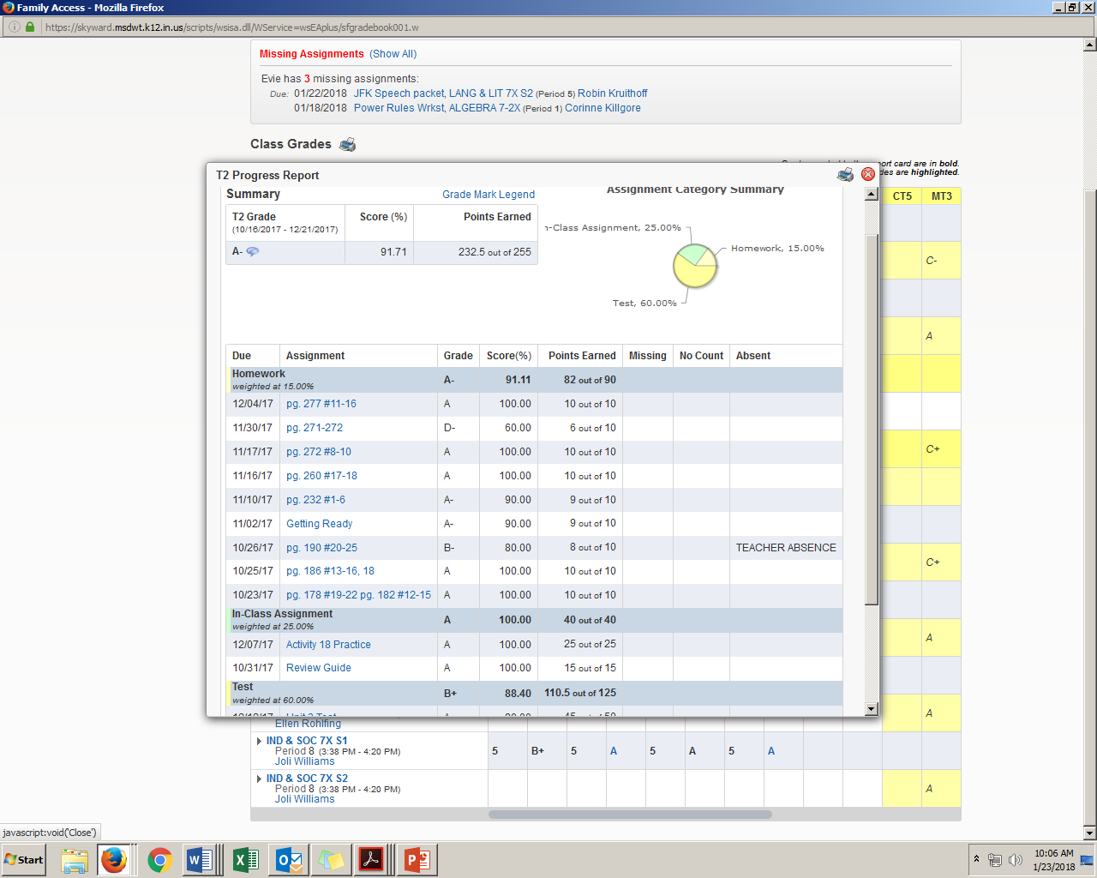

Slide 9
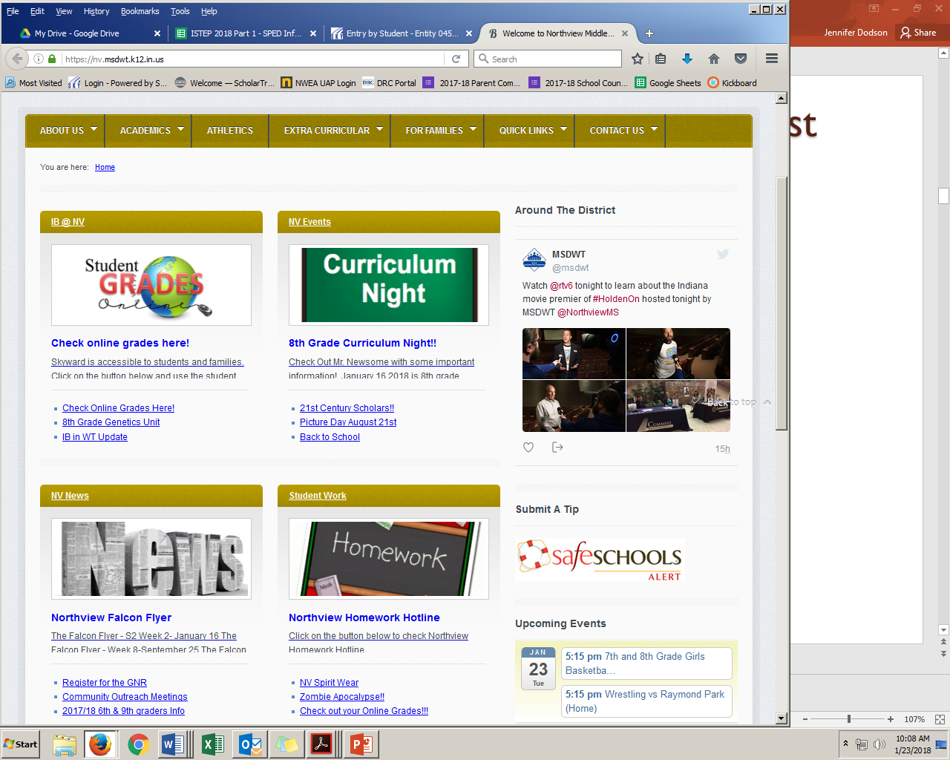
Homework Hotline – Your Best Friend!

Slide 10
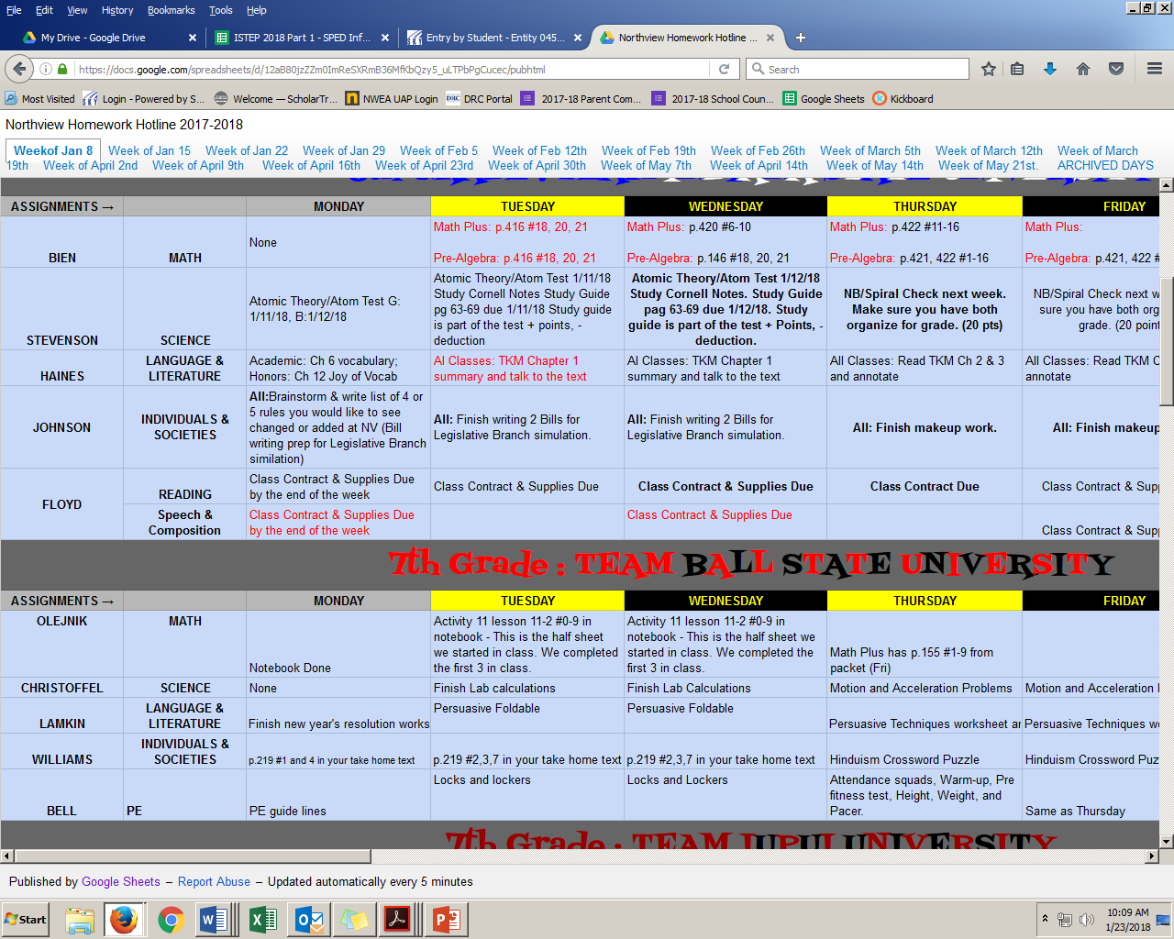

Slide 11
Required Classes:
Science
Language & Literature (English)
Language Acquisition (World Language)
Math
Reading (one semester)
Physical Education (one semester)
Individuals & Societies (Social Studies)
Advisory
Notes:
HB

Slide 12
LANGUAGE & LITERATURE
(English)
Explore a wide variety of fiction and
nonfiction texts
Discover a writing process and composition strategies using a 6+1 Trait framework
Identify and practice correct grammar and usage in written expression
Expand listening and speaking skills
Notes:
NEWSOME

Slide 13
Math
Hands-on activities and projects with real-world applications
Real number sense and computation
Geometry and Algebra
Computer-Based Interventions
Mathematics Placement:
Placement is determined by classroom grades and test scores from fifth grade.
Two levels of honors math:
  Enriched Math 6
  Pre Algebra X
Notes:
NEWSOME

Slide 14
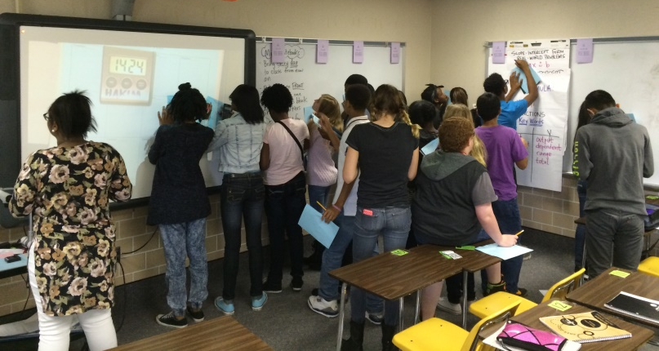
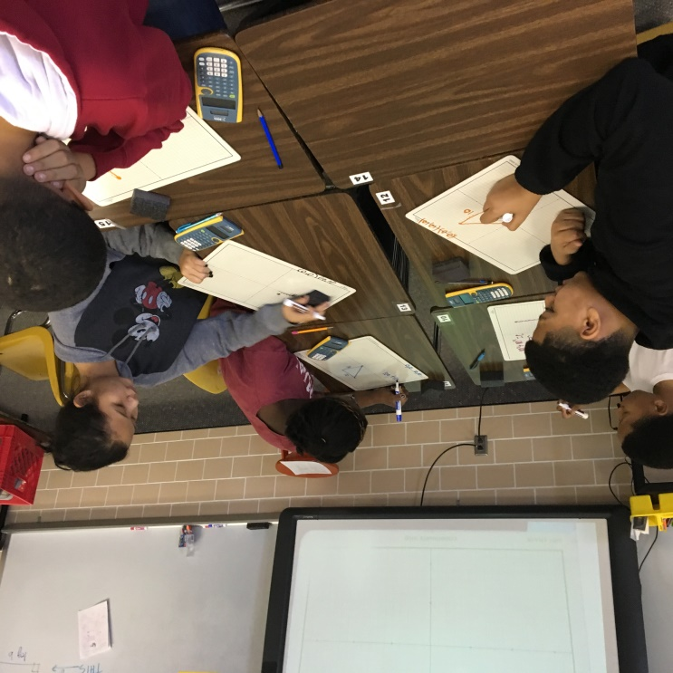
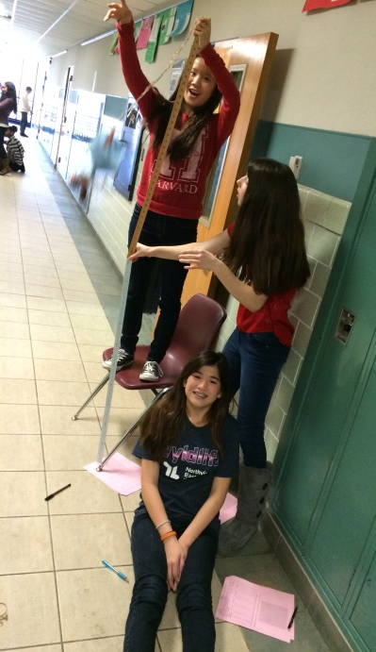
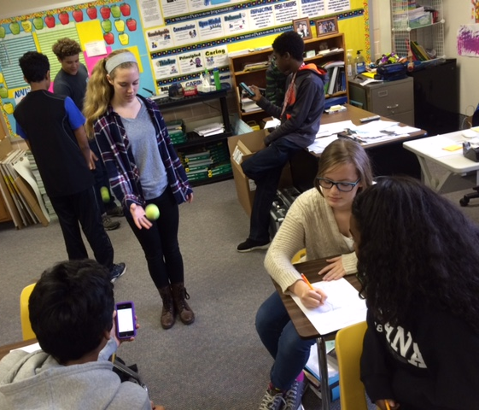
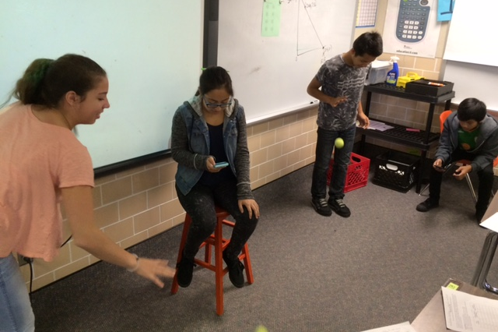
Northview Math Classes

Slide 15
Individuals & Societies
(Social Studies)
Geography
Ancient European history
Middle Ages
Central & South America
Modern European culture
CANVAS/ Technology Skills
Notes:
NEWSOME

Slide 16
Science
Scientific Method
Measurement
Ecology
Matter
Energy
Space
  Sun-Earth-Moon
  Planet comparisons
Year-long focus on Scientific Design & Inquiry
Notes:
NEWSOME

Slide 17
Language Acquisition:
World Language
Year-long course: choose between French and Spanish.
This is your choice for all three years. Choose wisely!
Three years of middle school world language is the equivalent of taking Spanish 1-2 or French 1-2.
Priority is given to qualified students who turn in a course sheet on time with a parent signature.
You may not be placed in your first-choice option.
Notes:
DODSON

Slide 18
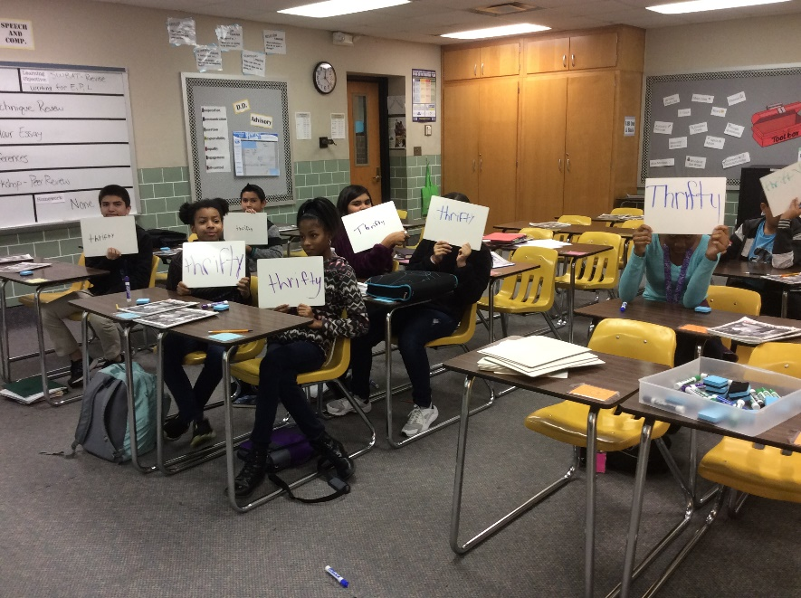
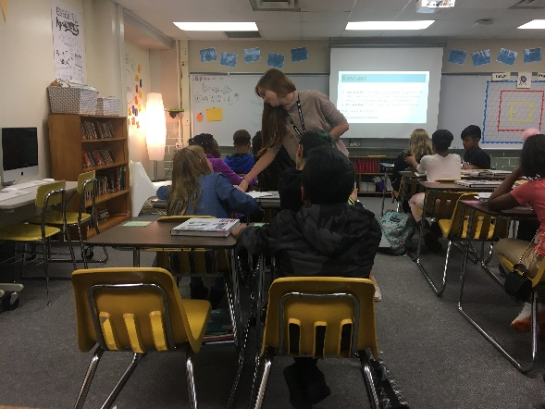
Reading
Weekly Reading Logs
Unit 1: Decoding Texts
Reading Strategies
Unit 2: Live Your Dream
Goal-setting
Unit 3: Heroes - Little Rock Girl, 1957
Personal and Cultural Expression
Unit 4: Stories of Survival
Communication & Connections
Notes:
NEWSOME

Slide 19
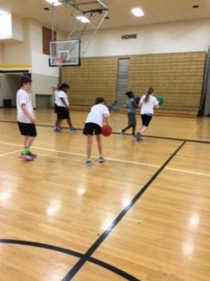
Physical Education/Health
(Semester Class)
Physical Education
Team sports/Group games
  FitnessGram testing
  Kickball, roller skating, volleyball, basketball, etc.
  Pacer Test
  Recreational exercise for healthy living
Health
Nutrition-My Healthy Plate, food groups
Physical Fitness-components of fitness
Hygiene-being a smart consumer
Notes:
NEWSOME

Slide 20
Advisory
Small, diverse groups of students that mirror the makeup of the school
Focus on the development of the middle school adolescent—social-emotional skill building
Addresses unwritten curriculum: how to “do” school – study skills, communication, etc.
Meet for 30 minutes four times per week
Advisory teacher often serves in a mentor role in the student’s school life
Notes:
DODSON

Slide 21
Related Arts Classes
Enrich your middle school experience with a variety of exciting elective classes!
Performing Arts classes involve a one-year commitment.
Notes:
DODSON

Slide 22
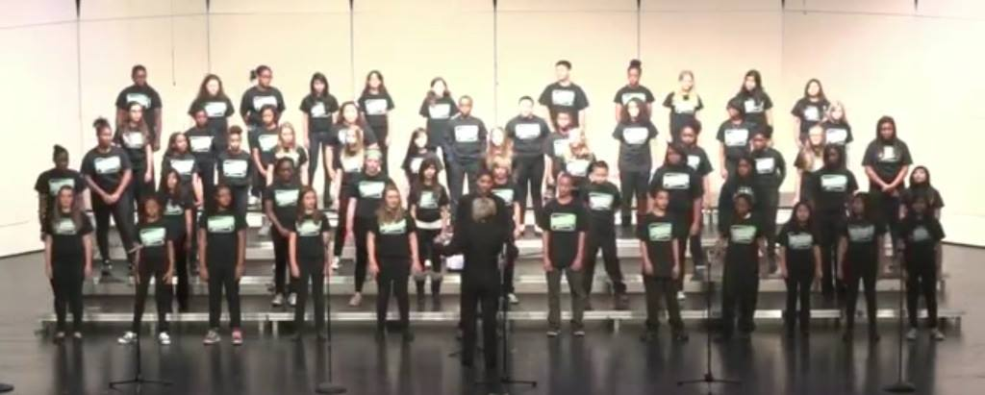
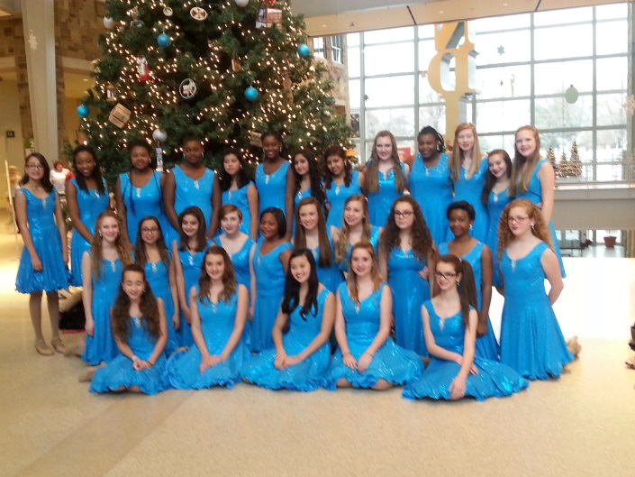
Choir
Full Year Course
Four performances during the 6th grade year
Learn to read music
Learn a variety of music
Township Choral Festival on alternate years
Notes:
DODSON

Slide 23
Orchestra
Full Year Course
Learn to play the violin, viola, cello, or string bass
Learn to read music
Four school performances during 6th grade year
Notes:
DODSON

Slide 24
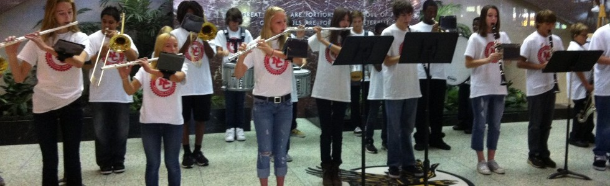
Band
Full Year Course
Learn to play the flute, oboe, clarinet, trumpet, French horn, trombone, baritone, tuba or percussion
Learn to read music
Three performances during 6th grade year
Notes:
DODSON

Slide 25
Computer Applications
Keyboarding Typing Skills
Projects
  Microsoft Word, Excel, and Power Point
  Inspiration, Comic Life, and Photo Booth
  iMovie and GarageBand
  Internet Research
Digital Video, Audio, and Image editing and scanning
Notes:
DODSON

Slide 26
Exploring Music
Computer-based course
Students learn how to read music
Music history
Basic piano keyboarding skills

Slide 27
Coding
Explore computer programming in the worlds of gaming, app development, and problem solving
Expand critical thinking and reasoning skills
Develop an understanding of core programming concepts, such as:
  Computer processing
  Algorithms
  Loops
  Conditional logic
  Functions
Explore and discuss the
role of technology in society

Slide 28
Art
Understand the importance of art past, present, and future
Learn independent creativity and self evaluation
Expand critical thinking and problem solving skills
Experience a variety of art mediums and techniques
Recognize different careers in art
Learn about art from different cultures
Washington Township Artistically
Talented Program
Notes:
DODSON

Slide 29
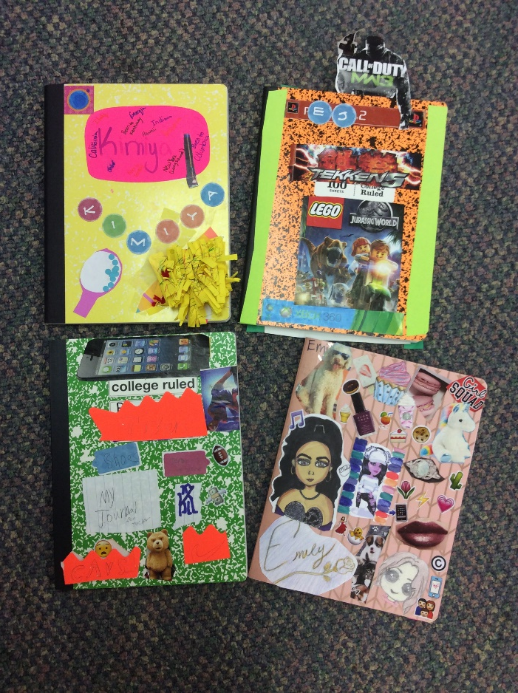
Speech & Composition
Intended for students who have proficient or advanced language arts skills
Great elective option for students who love to read and write
Writer’s Workshop Format: free-writing, literary, persuasive, and research essays
Presentation/Speech Strategies
Writer’s Notebook

Slide 30
Targeted Interventions
Depending on student needs, students may be assigned to one or more of the following:
Math Intervention
English/Language Arts Intervention
Read 180
Math 180
English as a New Language
Special Education Resource
Notes:
DODSON

Slide 31
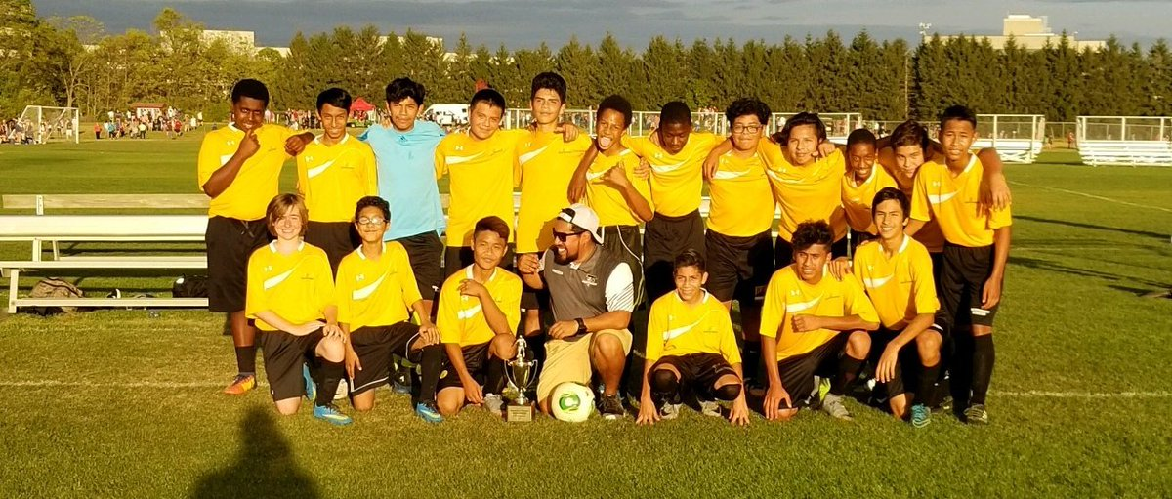
6th Grade Athletics
Cross Country
Track
Tennis
Wrestling
***Must have updated physical form on file.
Notes:
Wallace

Slide 32
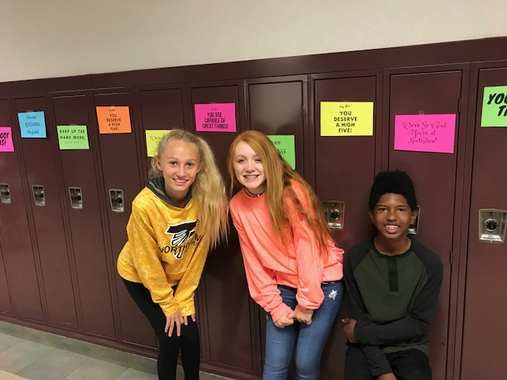
Get Involved!
Students must have a 2.0 or better
GPA in order to participate in the
following activities:
Academic Pursuit Green Team
Artistically Talented Equality Alliance
Athletic Teams Multi-Cultural Scholars
Builders Club Robotics Club
Destination Imagination Spell Bowl
Drama NV Student News Crew
Falcon Men of Purpose Student Ambassadors
Girls First Club
Notes:
Wallace

Slide 33

Next Steps…
Course Request Sheet completed and turned in to 5th grade teacher by Feb. 5.
Online Course Requests
  Counselors will complete course requests with each student in early February.
  A list of requested courses will be sent home.
  Changes can be made online via Skyward Family Access or by marking changes on the sheet and sending to 5th grade teacher.

Slide 34
Upcoming Transition Activities
Date | Transition Activity
February 5-20 ***Before this date, discuss course offerings with your child. | Meet the Counselor Conferences & Music Try-ons *Your child will complete course selections with the counselor.
No later than February 20 | Students bring home a copy of their course selections to review with parent/guardian.
Wednesday, January 31– 8:15 am | Middle School Meet-up: Informal parent meeting at Northview to address any questions or concerns you may have.
March 1 | Due date for course selection changes - can be completed by parents via Skyward Family Access or by marking changes on course request print-off
Tuesday, March 13 – 7-8:30 pm | Northview Open House
May 8 or 9 | 5th Graders Visit Northview
Monday, July 30 – 5:30-7:30 pm | FalconQuest: New Student Orientation
Notes:
Kaiser

Slide 35
Thank you for coming!
See you next school year future NORTHVIEW FALCONS!!!
Notes:
Kaiser

