Slide 1
Reopening Northview
Today we will discuss:
Arrival, Breakfast & Dismissal
Schedule, Restroom Breaks, Transitions, Walk & Talk
Backpacks, Charging Chromebooks, ID’s, Media Center

Slide 2
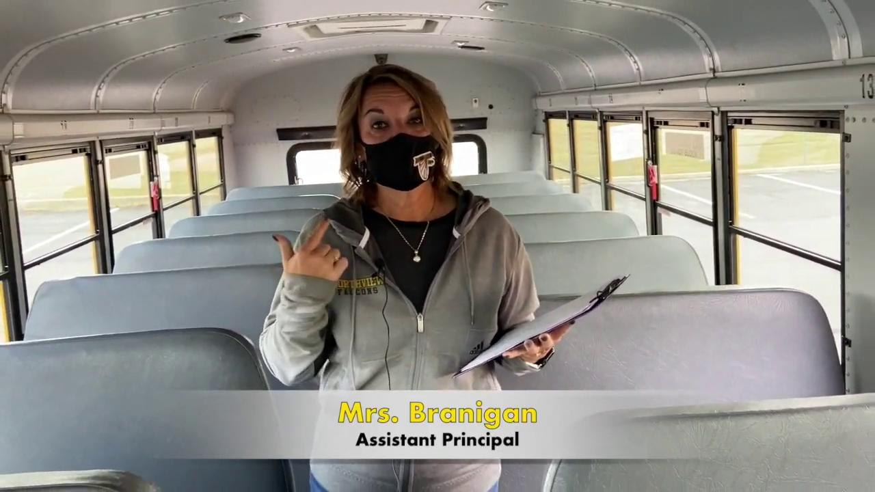
You Finally Made it To School! Now What…?
Bus Arrival:

Slide 3
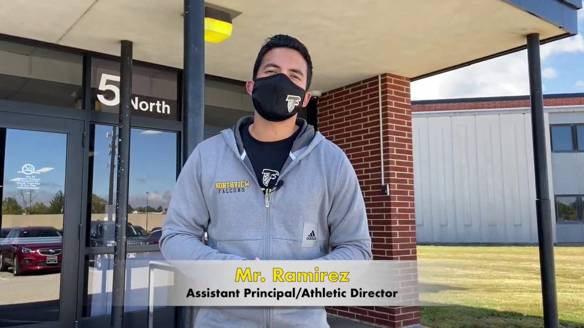
You Finally Made it To School! Now What…?
Car Arrival:

Slide 4
What is YOUR arrival plan?
If you are a Car Rider… Give a “Thumbs Up” to the camera.
If you ride the bus… Type “bus” into the chat.
If you are staying virtual… Hold up a “V” to the camera.
Notes:
Teachers: Use this time to make sure students know what their OWN plan is for arrival. Make this as interactive as you can… having students think through how they will get to school, and what door they will enter when they get here.

Slide 5
What is YOUR arrival plan?
Use your fingers to hold up the number of the door YOU will come in.
Car Rider? You’re Door #5! Bus Rider?
Door #1 for most students Door #24 if you are a 6th grader ffda Door #18 if your bus is in the back
#1 - #24 - #18
Notes:
Teachers: 6th grade teachers - if the student’s bus is before Door 1 and closest to #24 (6th grade wing), they they will use door #24. We have not been told yet where buses are pulling up at NV. Students just need to know to enter to the closest door to where their bus is parked.

Slide 6
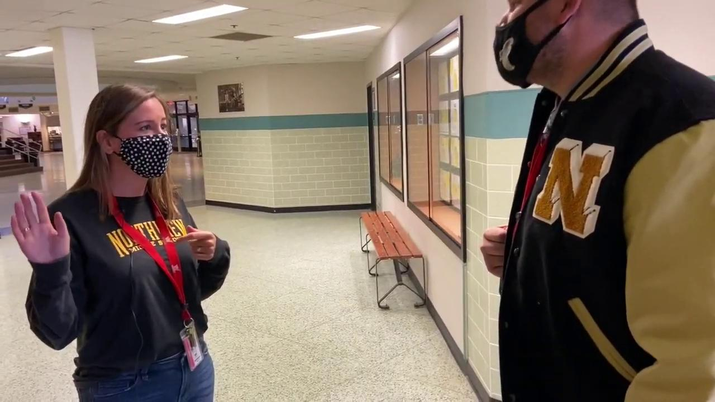
You made it in the building...Hungry??

Slide 7
What is YOUR Breakfast Plan?
If you will eat breakfast AT HOME, give a thumbs up to the camera.
If you will eat breakfast AT SCHOOL, type “Yum” into the chat.

Slide 8
Let’s Put It All Together
Picture this…
You just got to your first day of school.
Is it a Red Day or a Black Day?
What time is it?
Do you get out of your car or do you come off the bus?
What door do you walk in?
Still need to eat breakfast? If so, where do you go now?
Already full? Where will YOU go now?
Notes:
Teachers: Ask students who are joining us in the Hybrid model to share their answers with their Advisory.

Slide 9
You made it to the end of the day! Now What??
You have 3 options!
Option 1 :
Picked up in a car?
Go to auditorium.
Look for your name on the projector.
Is your name there? If yes, go immediately to Door 6.
Is your name there? If no, have a seat in the auditorium and watch for your name. Once you see your name, leave thru Door 6.

Slide 10
You made it to the end of the day! Now What??
Option 2 :
Going home on a bus?
Go to SAME door that you entered NV in the morning.
Only 6th graders may use Door 24
Notes:
Teachers: Explain that they can exit doors to the outside that they are closest to after their last class. Only 6th Graders should use Door 24 in the 6th grade hallway.

Slide 11
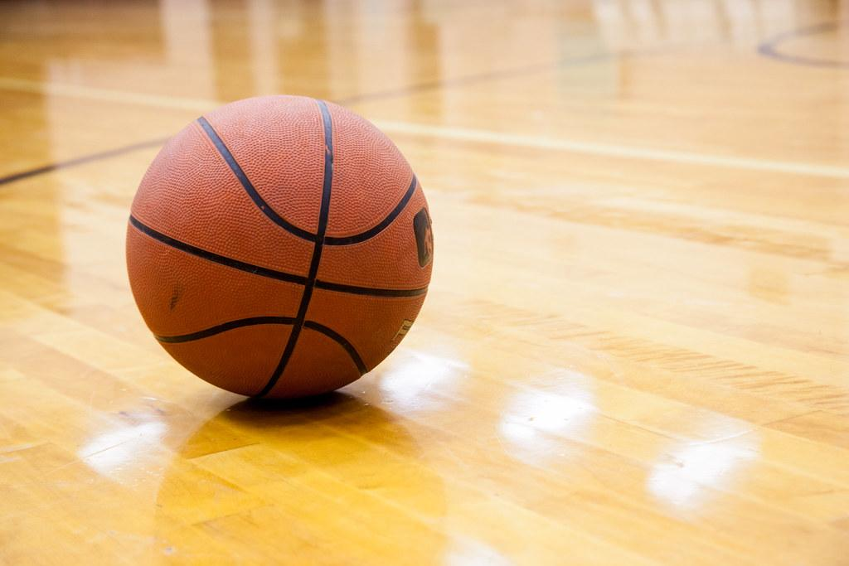
You made it to the end of the day! Now What??
Option 3 :
Going to practice?
You will go straight to the large gym and have a seat in the bleachers practicing social distancing. Masks up!
Your coach will meet you there.

Slide 12
CELL PHONE POLICY
Safe : Phones are to be kept inside your backpack which will be with you during the day. NV is not responsible for lost or stolen cell ph0nes.
Respectful : Phones must be turned OFF during the day.
Responsible : Phones are stored inside your backpack.
If your phone is taken, your parent must come to school and pick it up. Parents can choose to leave it at school for a week and then admin will return it to the student,
Northview practices “See it. Hear it. Take it.” when it comes to cell phones during school hours.
X
Notes:
Teachers: This is new for 6th graders and new students to NV in 6th and 7th grade. It is also going to be mentioned during our webinar with parents.

Slide 13
Let’s Put It All Together
AJ rode the bus to school and has basketball practice after school. At the end of the day, AJ should
Walk from science class to Door 5 with his girlfriend and then meet up with the guys in the gym.
Walk from science class to the gym and shoot hoops until Coach Warren gets to the gym.
Walk from science class to the gym. Find a seat on the bleachers that is socially distant from his teammates and wait for Coach Warren to arrive.
Notes:
Teachers: Answer is C. Students can share answers in chat or ask for volunteers. Go through why the answers are wrong for A & B.

Slide 14
Let’s Put It All Together
Celia has her cell phone in her backpack. She decides to take it out at lunch and her friends do a Tic Tok at lunch. Mr. Ramirez tells Celia
That he is a better at Tic Tok than her and her friends.
That she needs to hand him the phone and her parents can pick it up after school.
To put her phone in her locker.
Notes:
Teachers: Answer is B. Students can share answers in chat or ask for volunteers. Go through why the answers are wrong for A & C. Remember, We aren’t using lockers!

Slide 15
Let’s Put It All Together
Jack is a car rider and grandpa is picking him today. When car riders are picked up, Jack should
Walk to the auditorium. Enter the auditorium and look for his name on the projector. If it is there, leave thru Door 6. If his name isn’t listed, Jack should sit and wait until he sees his name and then leave thru Door 6.
Exit Door 5 and walk down the car line to see if Grandpa Joe is waiting on him. If Grandpa Joe isn’t there, then Jack should sit on the curb and wait.
Walk with his friends to Door 1 and then to their bus. Jack then leaves and heads to the Auditorium and waits for Ms. Paul to tell him that Grandpa Joe is here.
Notes:
Teachers: Answer is A. Students can share answers in chat or ask for volunteers. Go through why the answers are wrong for B & C. For B - students must stay socially distanced so we are having everyone stay in the auditorium so we can supervise better. For C - At dismissal, students go immediately to their destination.

Slide 16
Weekly Outline
Monday | Tuesday | Wednesday | Thursday | Friday
*Asynchronous: Visit all 1-8 canvas pages and complete the given work | Periods 1 - 4 (Red Day) | Periods 5 - 8 (Red Day) | Periods 1 - 4 (Black Day) | Periods 5 - 8 (Black Day)
All Student Virtual | In Person (A-K) | In Person (A-K) | In Person (L-Z) | In Person (L-Z)
*Asynchronous day will change depending on the given week. The week of the 25th our Asynchronous day is Thursday and not Monday.

Slide 17
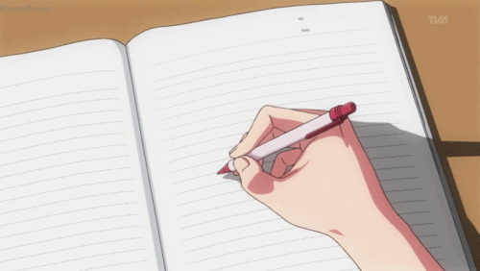
What is My New Schedule?
You have 1 minute to go get a paper and pencil to write down your new class times
Write the entire schedule including the zoom start times.

Slide 18
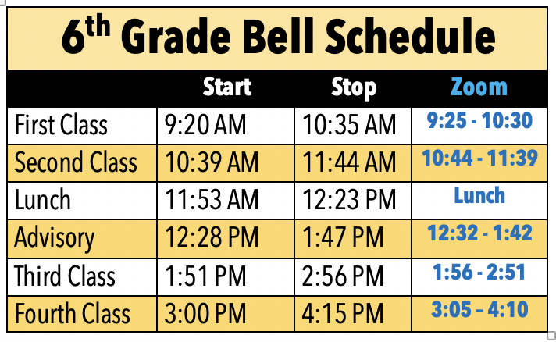
Notes:
Teachers make sure to share that the last 5 or so minutes of class is for cleaning up and wiping down desks.

Slide 19
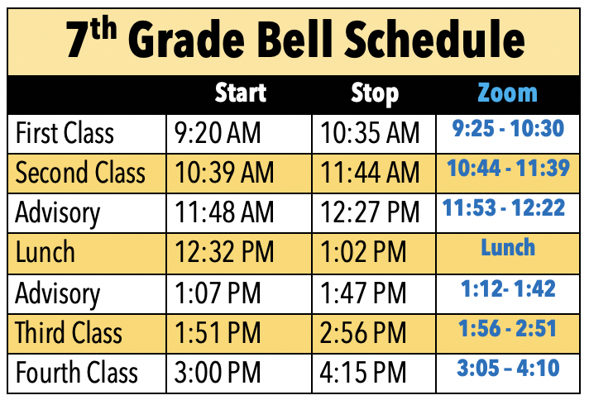
Notes:
Teachers make sure to share that the last 5 or so minutes of class is for cleaning up and wiping down desks.

Slide 20
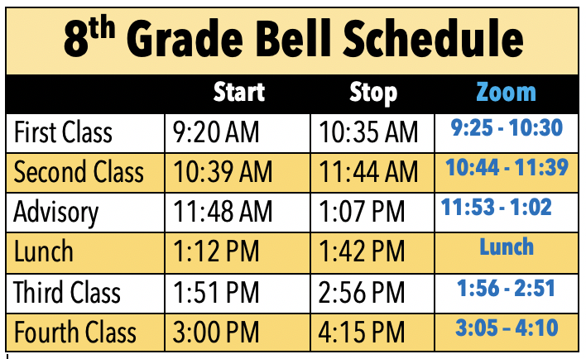
Notes:
Teachers make sure to share that the last 5 or so minutes of class is for cleaning up and wiping down desks.

Slide 21
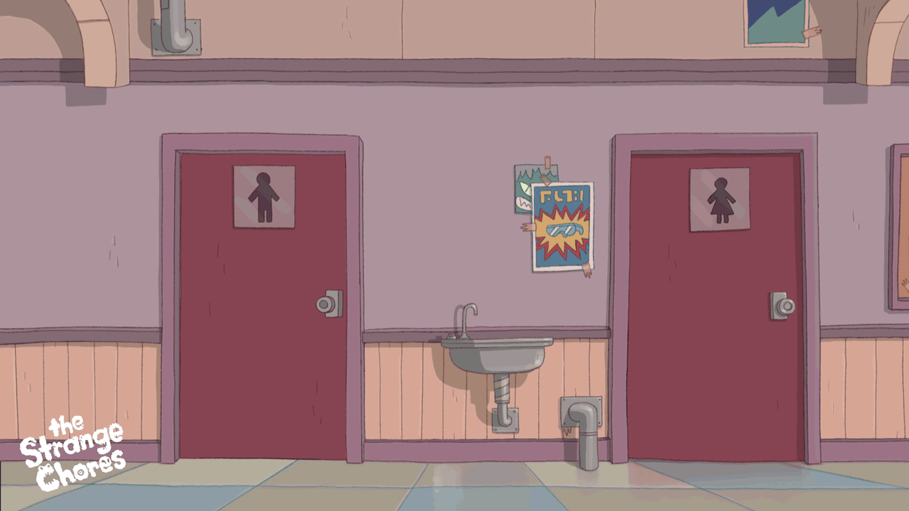
When Can I use the Restroom?
To keep Northview safe and clean, there will be certain times your teacher takes the class to the restroom.
-The first class of the day
-Advisory
-The last class of the day
To help with contact tracing, if you HAVE to use the restroom at another time because of an emergency, your teacher will write you a pass

Slide 22
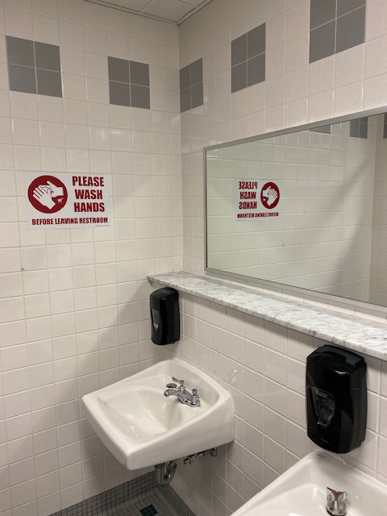
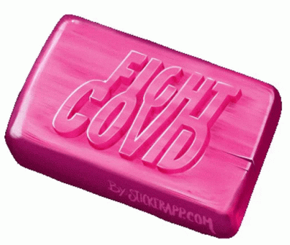
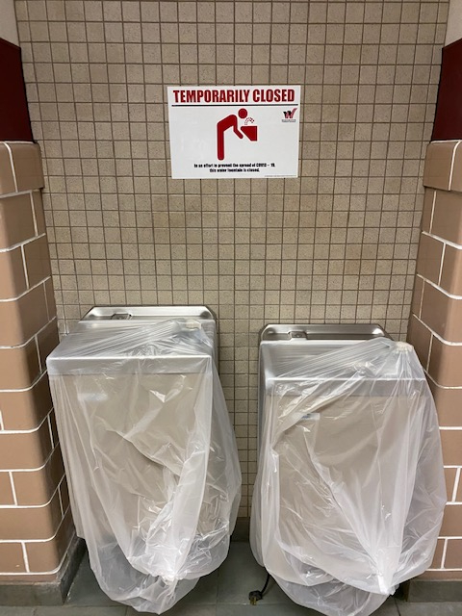
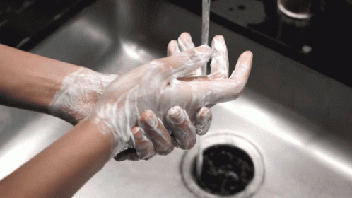
Bring a Water Bottle

Slide 23
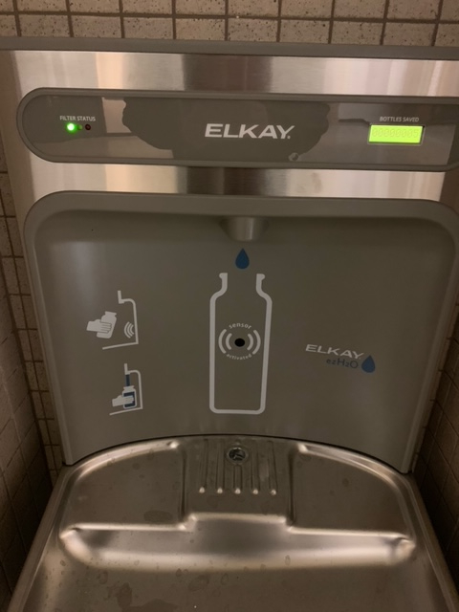
Where can I fill up my water bottle?
There are fill-up stations throughout the school. You may briefly stop on your way to your next class to fill-up your water bottle. If there is a line, move on…

Slide 24
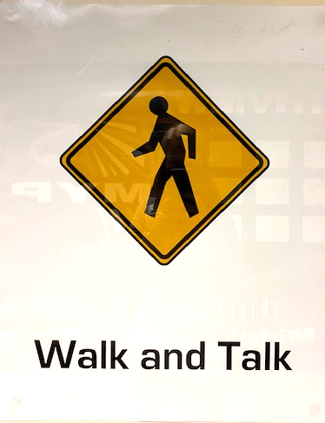
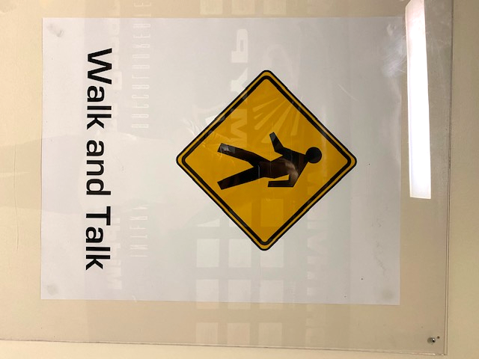
The Importance of moving in the Hallways

Slide 25
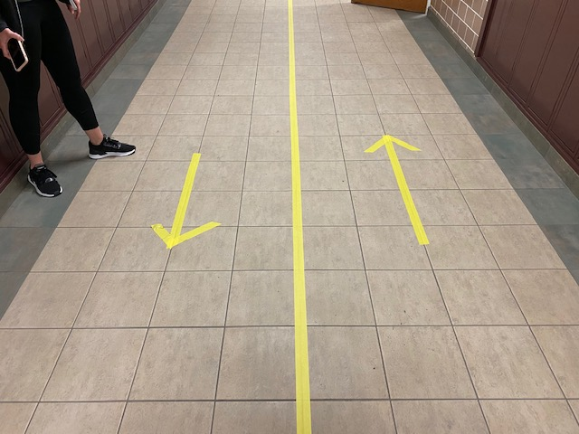
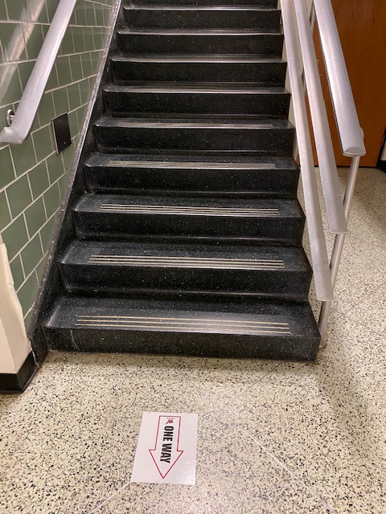
Follow the Arrows and Stay on Your Side

Slide 26
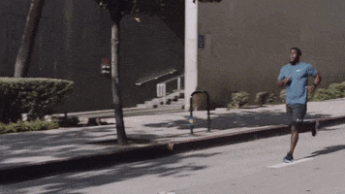
Wrong Way

Slide 27
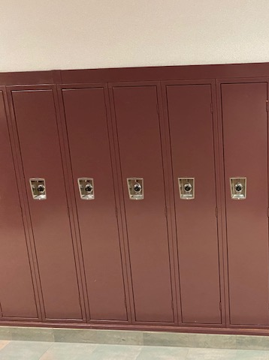
Lockers will be off limits. This should help prevent students from “hanging out” in the hallways. Carry all needed supplies with you in your backpack. Remember to pack everything the night before.

Slide 28
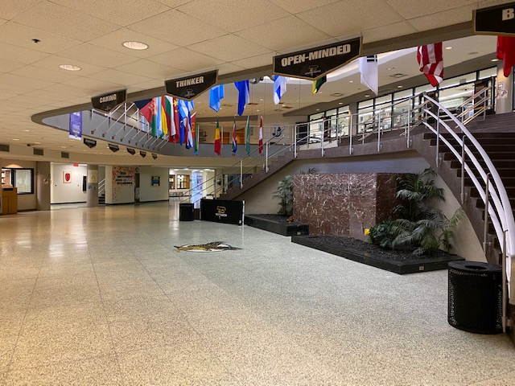
You should move directly to your next class. There will be no “hangouts” in the Falcon Center. Keep it moving!

Slide 29
Important Recap
It is your responsibility to know when each class starts, write down the schedule.
Only use the restrooms during the given break times.
Bring a water bottle for the filling stations, water fountains are closed
There will be no lockers
Walk and Talk- go DIRECTLY to class, no hanging out in the hallways.
Follow the signs and walk on the right side of the hallway.
You must wear a mask 100% of the time including hallways and restrooms.
Social Distance in the hallways, away from peers
Students may not leave and re-enter classrooms

Slide 30
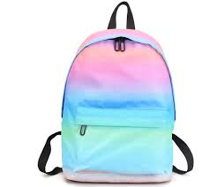
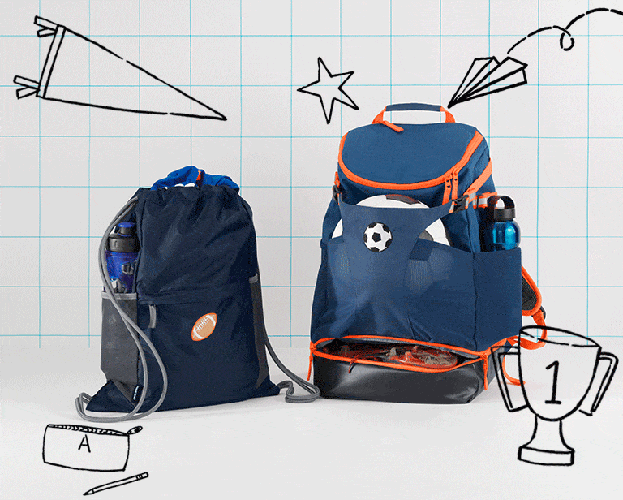
Backpacks
Reminder: There are NO locker stops.
All materials will be brought to class in your backpack.

Slide 31
What do I need to bring?
Folder(s)
Agenda
Pencil Pouch - pens, pencils, highlighters, hand sanitizer
Calculator
Water Bottle
Headphones
Lunch (if packing)
Phones stay OFF and INSIDE backpack
Notes:
Standard items

Slide 32
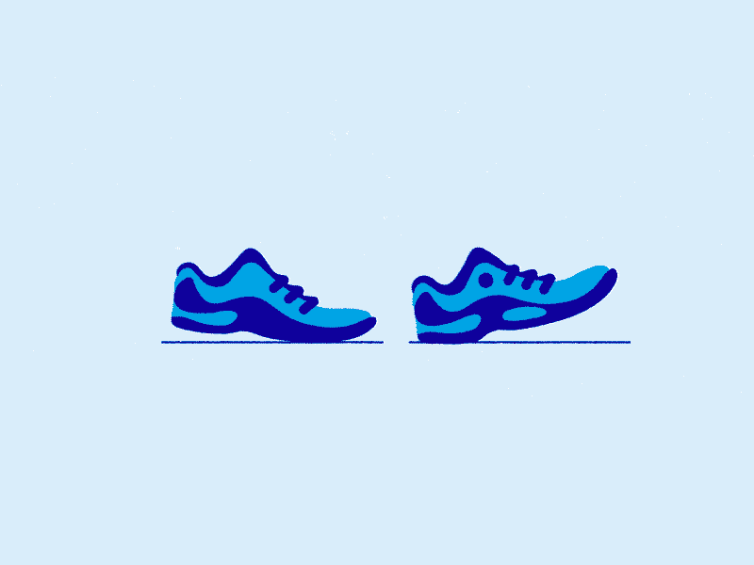
What do I need to bring?
Class specific items like...
Art Supplies (if you are in art)
PE (if you are in PE: tennis shoes, hand sanitizer, deodorant)
PE classes are not changing clothes and will not have access to locker rooms!
Items required by teacher (i.e. notebook)
Notes:
Class specific items

Slide 33
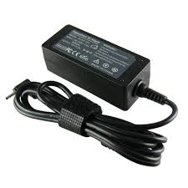
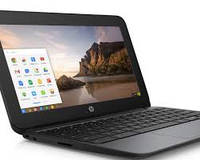
What do I need to bring?
FULLY Charged Chromebook
Charger
ID
Mask

Slide 34
Be Responsible! Be Prepared!
Take care of your computers.
Charge your computers EVERY NIGHT AND CLEAN them.
Bring charger to school every day (just in case)
Important to have with you due to limited paper access

Slide 35
Be Responsible! Be Prepared! Bring your ID!
You will get your ID in Advisory class.
YOU MUST have your ID for breakfast
and lunch
FYI: There will be no change if using cash in Cafe
Additional money will be added to your account
Replacement ID fee is $5

Slide 36
Be Prepared! Media Center Books for L&L
You will only have access to Media Center in L&L classes (with a pass), which means once during Hybrid days
Media Center Staff will continue to have books ready for students each Tuesday via online portal.

Slide 37
IMPORTANT RECAP:
ALL materials will be in your backpack!
Pack your backpack the night before!
CHARGE your computer EVERY NIGHT
MUST bring ID, charger, and computer every day
Media Center during L&L only with a pass.

